Slide 1
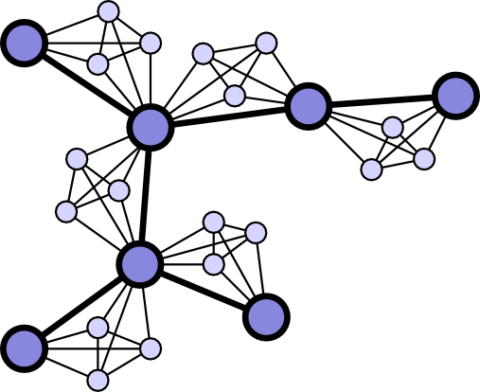
ALGORITHM & COMPLEXITY
Graph Algorithm
Course Coordinator: Dr. Salama A Mostafa
Address: FSKTM, 4th floor, Room No. 10
Email: salama@uthm.edu.my
Course Code: BIE 20303

Slide 2
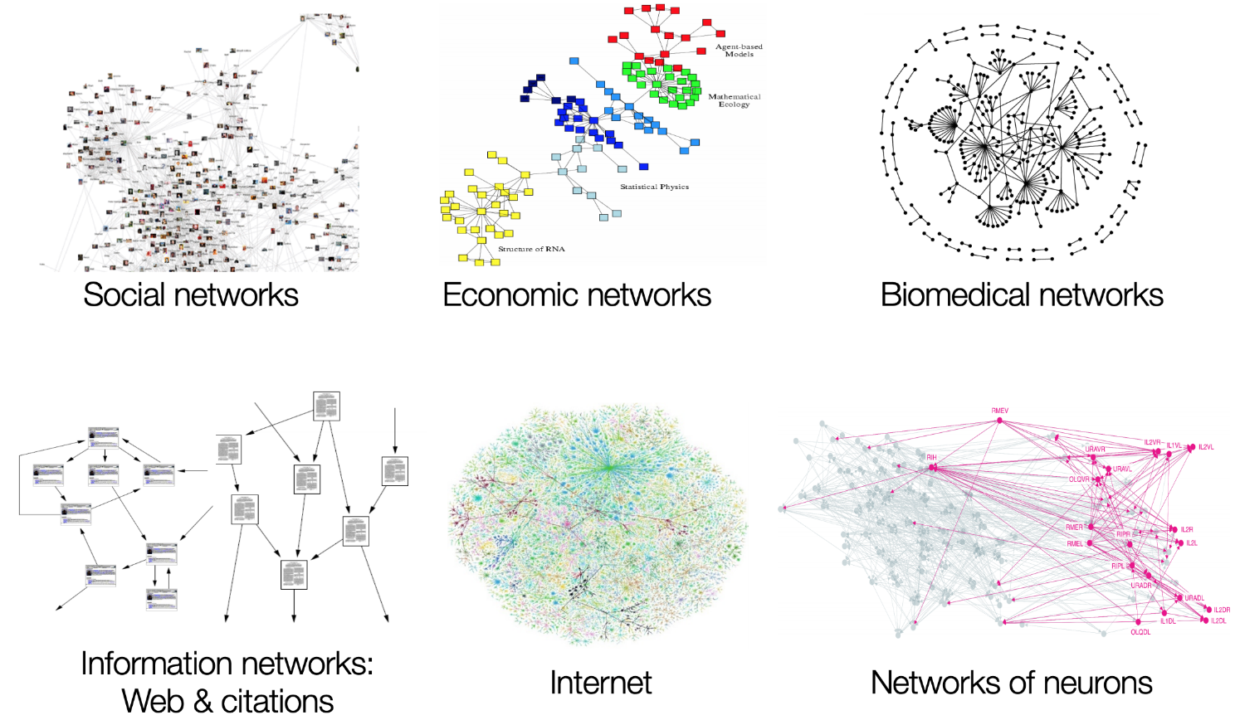
Graph: An Introduction
Graph Theory
It is a mathematical structure that models pairwise relations between objects in graphs form
Graph Problems
Connection problems
Scheduling problems
Transportation problems
Network analysis
Games and Puzzles

Slide 3
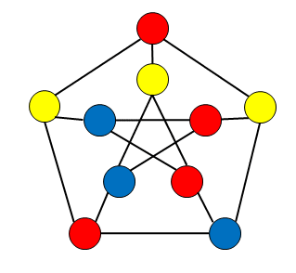
Graph: An Introduction
Graph
A graph is a set of vertices (nodes) and a set of edges (links) that connect pairs of distinct vertices
Mathematically we say:
G = (V, E) where
E ⊂ V×V
A graph may be undirected or directed
In an undirected graph, (u, v) ∈ E if (v, u) ∈ E
This implies that there are two edges (u, v) and (v, u) in an undirected graph. This is not correct, instead the edges of an undirected graph are simply pairs, not ordered pairs
Visually we represent the vertices as points (or labeled circles) and the edges as lines joining the vertices

Slide 4
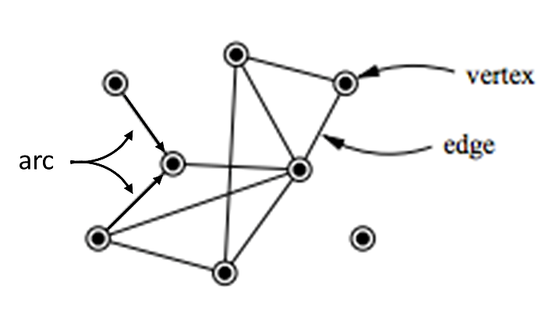
Graph: An Introduction
Graph Description
A graph is a set of items connected by edges (links)
Each item is called a vertex (node)
Formally, a graph G={V,E} is a set of vertices (nodes) V and a set of edges (links) E
Sometimes edges referred to as arcs

Slide 5
Graph Types
Undirected Graph
A graph whose every edge is undirected
If pairs of vertices (u,v) are unordered i.e a pair of vertices (u,v) is the same as the pair (v,u) so, the vertices u and v are adjacent to each other and they are connected by the undirected edge (u,v)
The vertices u and v endpoints of the edge (u,v) so, u and v are incident to this edge; also the edge (u,v) is incident to its endpoints u and v
Label vertices of a graph or a digraph with letters, integer numbers or if an application calls for it, use character strings.
The figure has six vertices and seven edges:
V = {a, b, c, d, e, f},
E = {(a, c), (a, d), (b, c), (b, f), (c, e), (d, e), (e, f)}
a
c
b
d
e
f

Slide 6
Graph Types
Directed Graph or Digraphs
A graph whose every edge is directed
If a pair is ordered or a pair of vertices (u,v) is not the same as the pair (v,u) so, the edge (u,v) is directed from the vertex u, called the edge’s tail, to the vertex v, called the edge’s head
Also the edge (u,v) leaves u and enters v
The figure has six vertices and eight directed edges:
V = {a, b, c, d, e, f},
E = {(a, c), (b, c), (b, f), (c, e), (d, a), (d, e), (e, c), (e, f)}
a
c
b
d
e
f

Slide 7
Graph Types
Weighted Graph
Definition:
A weighted graph G (undirected or directed) consists of a set V of vertices, a set E of edges, and a function w from E to the real numbers
The sets V and E are as described in the definitions of graph and digraph. w(e) is the weight or cost of e. Written as G = (V,E,w)
The figure has six vertices and ten edges:
The weight of each edge is shown on the edge
The weight of edge (A,B) is 30,
The weight of edge (A,D) is 50
A
100
30
F
B
50
30
70
40
40
10
C
E
10
D
20

Slide 8
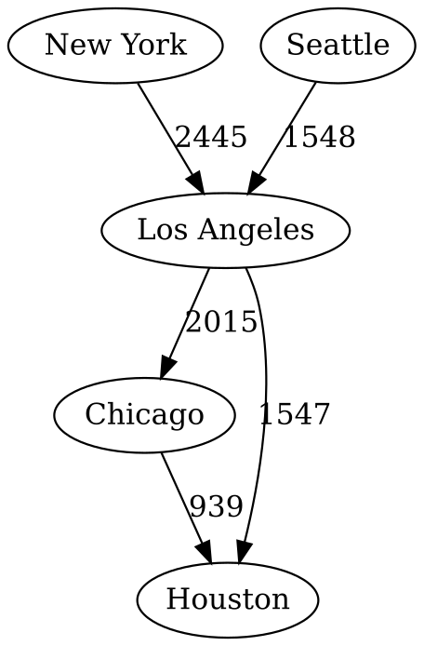
Graph Types
Weighted Graph
Applied in real world as a map of cities then, user use it to find the quickest route from one city to the other city.
Solving problem by computer algorithm
Graph Brute Force:
Depth First Search (DFS)
Breadth First Search (BFS)
Graph Greedy Algorithms:
Kruskal’s Algorithm
Prim’s Algorithm
Dijkstra’s Algorithm

Slide 9
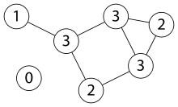
Graph Types
Connected graph
A graph if there is a path from every vertex to every other vertex
Disconnected graph
A graph that is not connected but consists of connected components

Slide 10
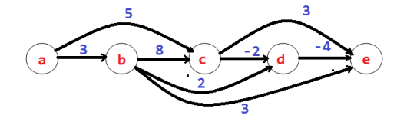
Graph Types
Path
A sequence of vertices in which each successive vertex is adjacent (next) to its predecessor
A simple path the vertices and edges are distinct
A cycle is a simple path in which the first and final vertices are the same
A path from vertex u to vertex v of a graph G can be defined as a sequence of adjacent (connected by an edge) vertices that starts with u and ends with v.
A cycle is a path of a positive length that starts and ends at the same vertex and does not traverse the same edge more than once

Slide 11
Graph Types
Graph Examples
Digraphs
V = {A, B, C, D, E}
E = {(A, B), (B, A), (B, E), (D, A), (E, A), (E, D), (E, C)}
Undirected Graph
V = {A, B, C, D, E}
E = {{A, B}, {A, D}, {C, E}, {D, E}}

Slide 12
Graph Types
Disconnected Graph Examples
Weighted Graph Examples

Slide 13
Graph Types
Path Examples

Slide 14
Graph Types
Cycle Examples

Slide 15
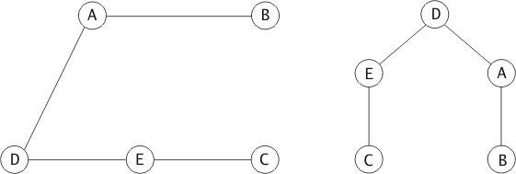
Graphs and Trees
Relationship Between Graphs and Trees
A tree is a special case of a graph.
Any connected graph which does not contain cycles can be considered a tree.
Any node can be chosen to be the root.

Slide 16
Graphs Representation in Programming
Two popular methods of graph representation:
Adjacency Matrix
A |V| × |V| matrix with 1 (or the weight) (or true) for an edge and 0 (or infinity) (or false) for not-an-edge
Adjacency List
A vector (linked list or array) of lists, one for each vertex. Each list has the adjacent vertices

Slide 17
Graphs Representation in Programming
Adjacency Matrix
A graph with n vertices (1,2,3,..., n), is n-by-n boolean matrix with one row and one column.
The element in the ith row and the jth column is equal to 1 if there is an edge from the ith vertex to the vertex jth, otherwise equal to 0.
Adjacency matrix for an undirected graph is always symmetric,i.e A[i, j] = A[j, i] for every 0 ≤ i, j ≤ n -1.

Slide 18
Graphs Representation in Programming
Adjacency Matrix of Undirected Graph

Slide 19
Graphs Representation in Programming
Adjacency Matrix of Directed Graph

Slide 20
Graphs Representation
Observations About Complexity of Adjacency Matrix
Generally |E| < < |V|²
i.e. the adjacency matrix is sparse
The adjacency list is preferred over the adjacency matrix for most applications
There are some applications, however, where the adjacency matrix is preferred
An algorithm that iterates over all of the edges by iterating over the vertices is O(V²)

Slide 21
Graphs Representation in Programming
Adjacency List
A collection of linked lists, one of each vertex, that contain all the vertices adjacent to the list’s vertex
Usually, the list starts with a header identifying a vertex for which the list compiled
Indicate columns of the adjacency matrix that, for a given vertex, contain 1’s
Less space than the adjacency matrix because we do not keep the 0’s

Slide 22
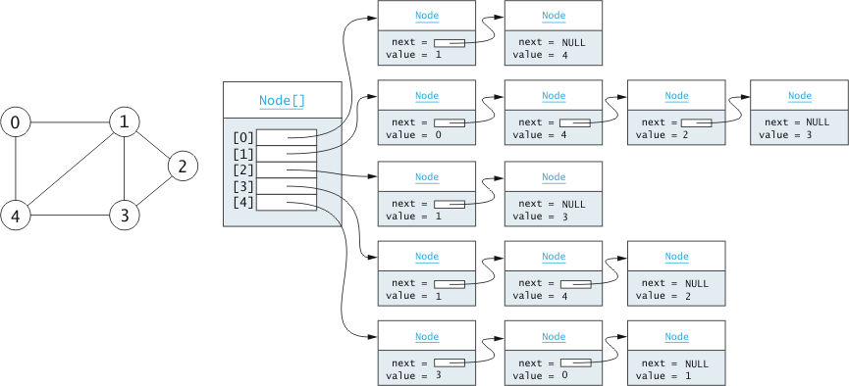
Graphs Representation in Programming
Adjacency List of Undirected Graph

Slide 23
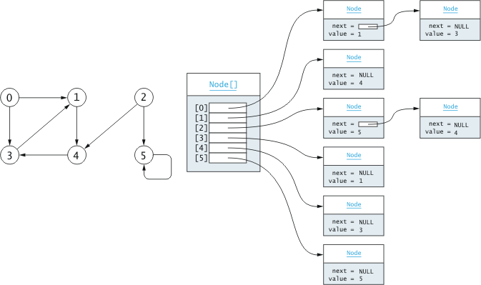
Graphs Representation
Adjacency List of Directed Graph

Slide 24
Graphs Representation
Observations About Complexity of Adjacency List
The operation
is_edge(int u, int v)
is O(|E_{v}|)
An iteration over all vertices adjacent to a given vertex is O(|E_{v}|)
An algorithm that iterates over all of the edges by iterating over the vertices is O(|E|)

Slide 25
Operations on graphs
Operations on a graph:
Create a graph of n vertices
Insert an edge
Remove an edge
Query the existence of an edge
Iterate over the vertices adjacent to a given vertex

Slide 26
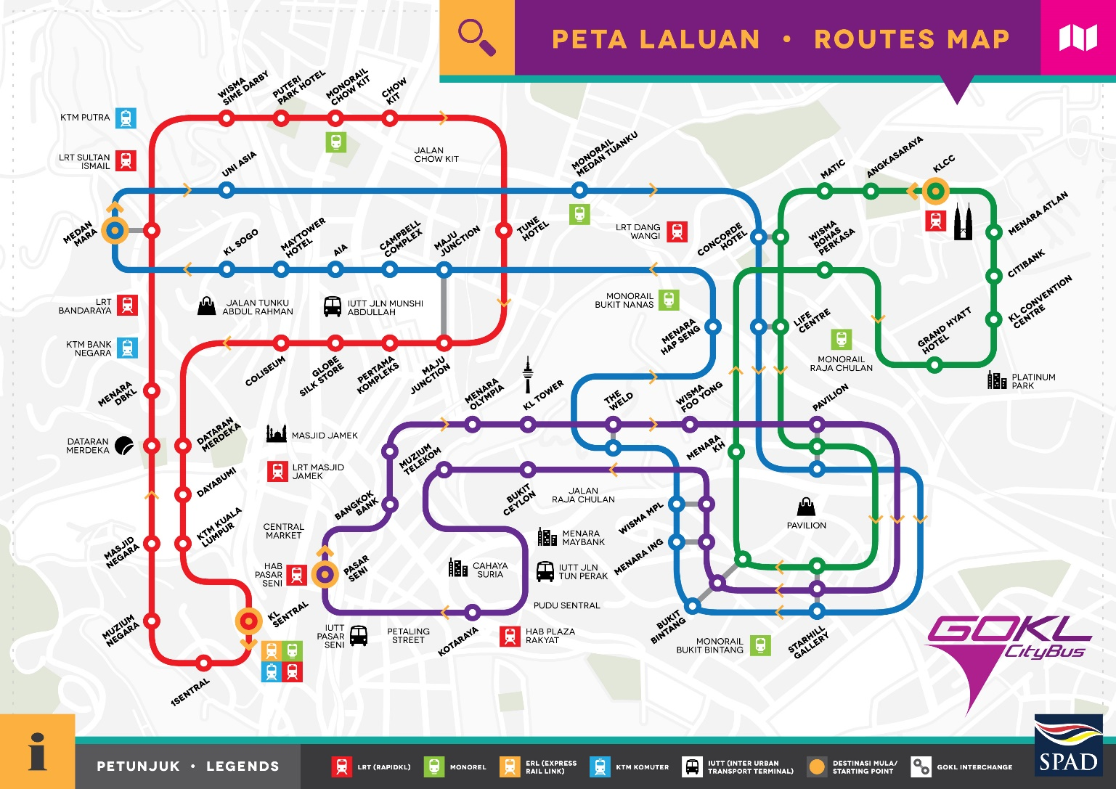
Graph Applications
Network connectivity
Scheduling
Finding the shortest path
Network routing
Travel planning

Slide 27
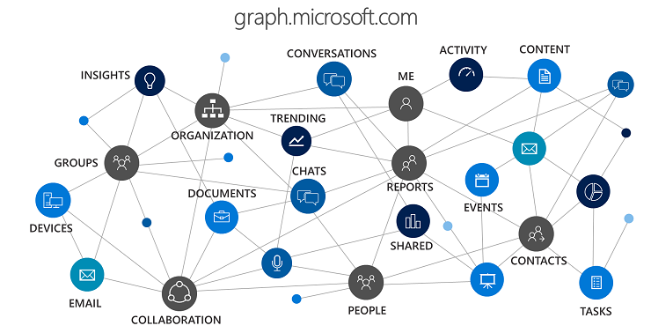
Graph Applications
The Graph Theory has important applications in
Critical path analysis,
Social psychology,
Matrix theory,
Set theory,
Topology,
Group theory,
Molecular chemistry, and
Searching

Slide 28
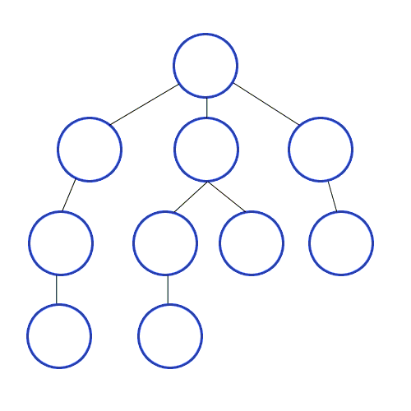
Brute Force Algorithms for Graph Traversal
Depth-first search
Explore graph always moving away from last visited vertex
Similar to preorder tree traversals
Pseudocode for Depth-first-search of graph G=(V,E)
DFS(G)
count :=0
mark each vertex with 0 (unvisited)
for each vertex v∈ V do
if v is marked with 0
dfs(v)
dfs(v)
count := count + 1
mark v with count
for each vertex w adjacent to v do
if w is marked with 0
dfs(w)

Slide 29
Brute Force Algorithms for Graph Traversal
Depth-first search notes
Start at some vertex
Follow a simple path discovering new vertices until you cannot find a new vertex
Back-up until you can start finding new vertices
for a Directed graph, a DFS may produce multiple
trees called a DFS forest
DFS Complexity can be represented with graphs as:
Adjacency matrices: Θ(V²)
Adjacency linked lists: Θ(V+E)

Slide 30
Brute Force Algorithms for Graph Traversal
Depth-first search applications
Checking connectivity, finding connected components
Checking acyclicity in graphs
Searching state-space of problems for Artificial Intelligence (AI) solution
A Depth First Search can be used to determine a topological sort of a Directed Acyclic Graph (DAG)
A topological sort is an ordering of the vertices such that if (u, v) is an edge in the graph, then v does not appear before u in the ordering
An application of this would be to determine an ordering of courses that is consistent with the prerequisite requirements

Slide 31
Brute Force Algorithms for Graph Traversal
Depth-first search algorithm
Start at vertex u. Mark it visited (color gray) and set its discovery time
For each vertex v adjacent to u
If v has not been visited
Insert u, v into DFS tree
Recursively apply this algorithm starting at v
Mark u finished (color it black) and set its finish time

Slide 32
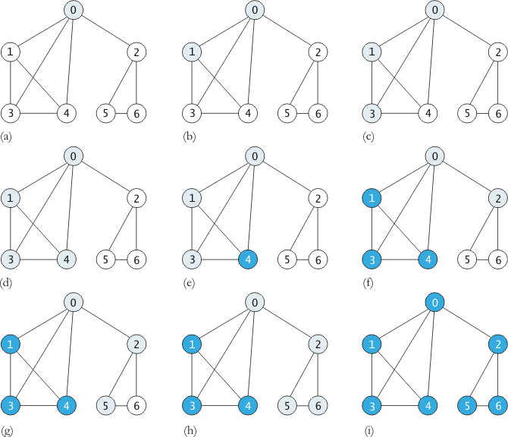
Brute Force Algorithms for Graph Traversal
Depth-first search Example

Slide 33
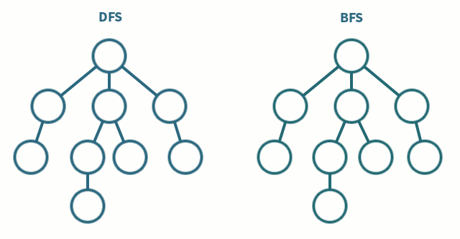
Brute Force Algorithms for Graph Traversal
Breadth-first search
Explore graph moving across to all the neighbors of last visited vertex
Similar to level-by-level tree traversals
Instead of a stack, breadth-first uses queue

Slide 34
Brute Force Algorithms for Graph Traversal
Breadth-first search algorithm
BFS has same efficiency as DFS and can be represented with graphs as:
Adjacency matrices: Θ(V²)
Adjacency linked lists: Θ(V+E)
Take a start vertex, mark it identified (color it gray), and place it into a queue.
While the queue is not empty
Take a vertex, u, out of the queue (Begin visiting u)
For all vertices v, adjacent to u,
If v has not been identified or visited
Mark it identified (color it gray)
Place it into the queue
Add edge u, v to the Breadth First Search Tree
We are now done visiting u (color it black)

Slide 35
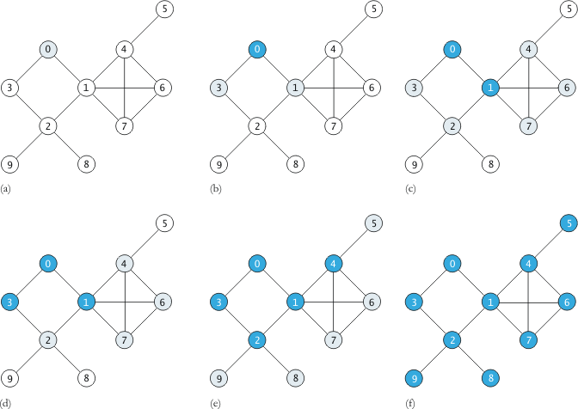
Brute Force Algorithms for Graph Traversal
Breadth-first search Example

Slide 36
Brute Force Algorithms for Graph Traversal
Breadth-first search applications
Applications are same as DFS, but can also find paths from a vertex to all other vertices with the smallest number of edges
A Breadth First Search finds the shortest path from the start vertex to all other vertices based on number of edges.
We can use a Breadth First Search to find the shortest path through a maze.
This may be a more efficient solution than that found by a backtracking algorithm.

Slide 37
Brute Force Algorithms for Graph Traversal
Depth and Breadth-first search Maze example

Slide 38
Greedy Algorithm for Graph Traversal
Greedy Algorithm
A greedy algorithm is one that attempts to find the locally optimal solution at each step
Some examples greedy algorithms of solving problem by computer graph:
Dijkstra’s Algorithm
Prim’s Algorithm
Kruskal’s Algorithm

Slide 39
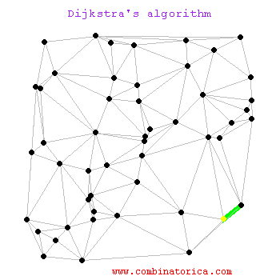
Greedy Algorithm for Graph Traversal
Dijkstra’s Algorithm
The famous computer scientist Edsger W. Dijkstra developed an algorithm to solve the shortest path problem
Given a graph we want to find the shortest path
from a starting vertex to some or all other vertices

Slide 40
Greedy Algorithm for Graph Traversal
Dijkstra’s Algorithm
Initialize sta[] with the start vertex, s, and rem[] with the remaining vertices, r in which (v-s=r)
for all r in rem[]
Set path pat[r] to s
if there is an edge (s, r)
Set distance dis[r] to weight(s, r)
else
Set distance dis[r] to ∞
while rem[] is not empty
for all unvisited u in rem[], find the smallest dis[u]
Remove u from rem[] and add it to sta[]
for all r adjacent to u in rem[]
if dis[u] + weight(u, r) is < dis[r]
Set dis[r] to dis[u] + weight(u, r)
Set pat[r] to u

Slide 41
Greedy Algorithm for Graph Traversal
Dijkstra’s Algorithm Shortest Path Example
Single source shortest path conditions
G=(V, E) must be directed
Edge weights must be non negative
9
8
13
10
14
∞
∞
b
1
d
b
1
d
10
10
a
9
a
9
2
3
4
6
start
2
3
4
6
5
c
e
5
c
e
2
2
∞
∞
5
7

Slide 42
Greedy Algorithm for Graph Traversal
Analysis of Dijkstra’s Algorithm
Step 1 requires v-s or |r| steps
The loop at Step 2 will be executed |v| – 1 times
The loop at Step 7 will be executed |v| – 1 times
Within the loop at Step 7
Steps 8 and 9 will search for |v – s| items
Thus Step 7 is |v| -1 + |v| - 2 + … 1 = O(|v|²)

Slide 43
Greedy Algorithm for Graph Traversal
Improving the Implementation of Dijkstra’s Algorithm
We use a triples to contain dis[u], u, pat[u]
We use dis[u] as the key for comparison
We then place these triples into a priority queue
Then we apply the breadth-first-search algorithm

Slide 44
Greedy Algorithm for Graph Traversal
Improved Dijkstra’s Algorithm
Take the start vertex and place the triple(0, s, -1) into the priority queue
While the priority queue is not empty
Take the triple with the smallest dis[u] out of the queue
If u has not been visited
Mark it visited and place (pat[u], u) into result t
For all vertices, v, adjacent to u
Compute dis[v] = dis[u] + weigh(u, v) and place (dis[v], v, u) into the priority queue

Slide 45
Greedy Algorithm for Graph Traversal
Analysis of Improved Dijkstra’s Algorithm
Assume that all edges get entered into the priority queue
Thus the loop is executed |E| times
If we use a heap for the priority queue,
each insert and removal is log |E|
Thus we have O(|E| log |E|)

Slide 46
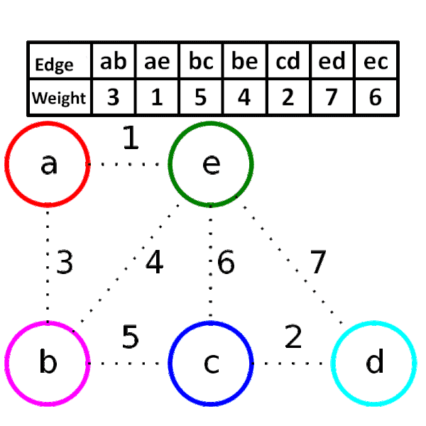
Greedy Algorithm for Graph Traversal
Minimum Spanning Tree
A spanning tree means all vertices must be connected
A minimum spanning tree (MST) is a subset of the edges of a connected, edge-weighted undirected graph that connects all the vertices together, without any cycles and with the minimum possible total edge weight
Let G = (V, E) be an un-directed weighted graph
Wish to find an acyclic subset T ⊆ E such that
w(T) = ∑_{(u,v) ∈T} w(u,v) is the minimum

Slide 47
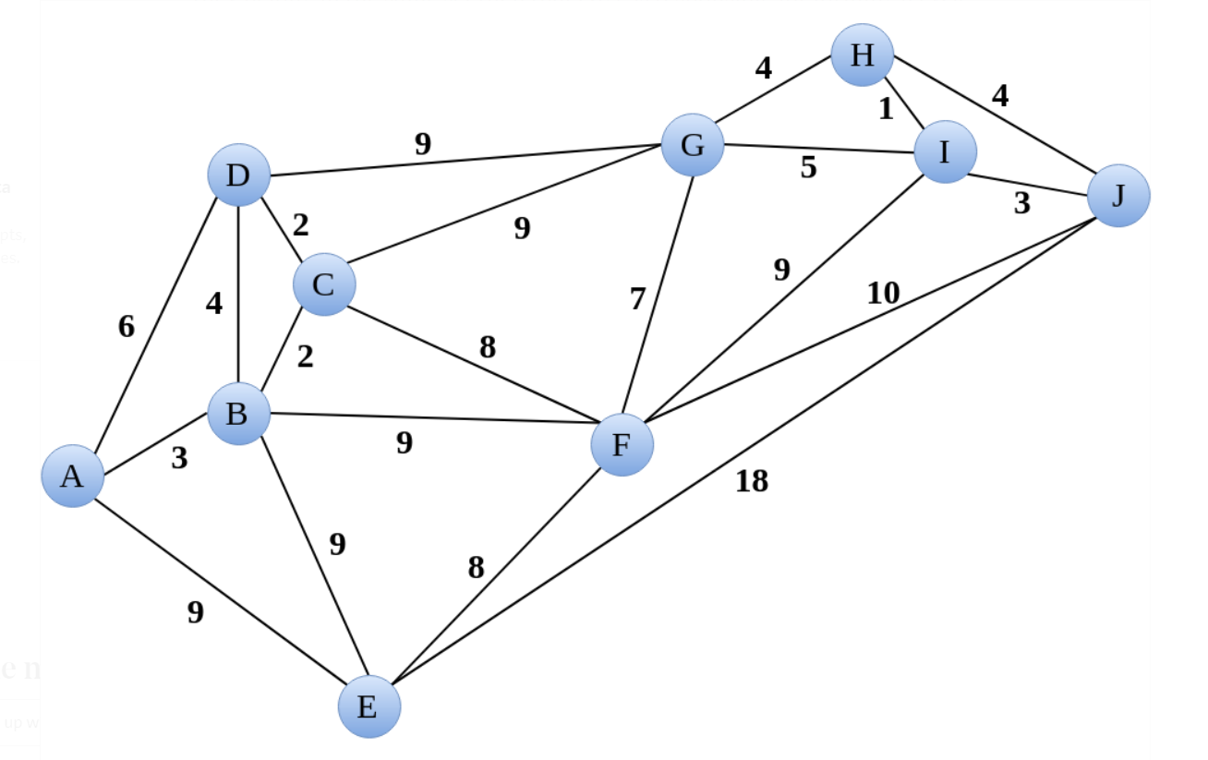
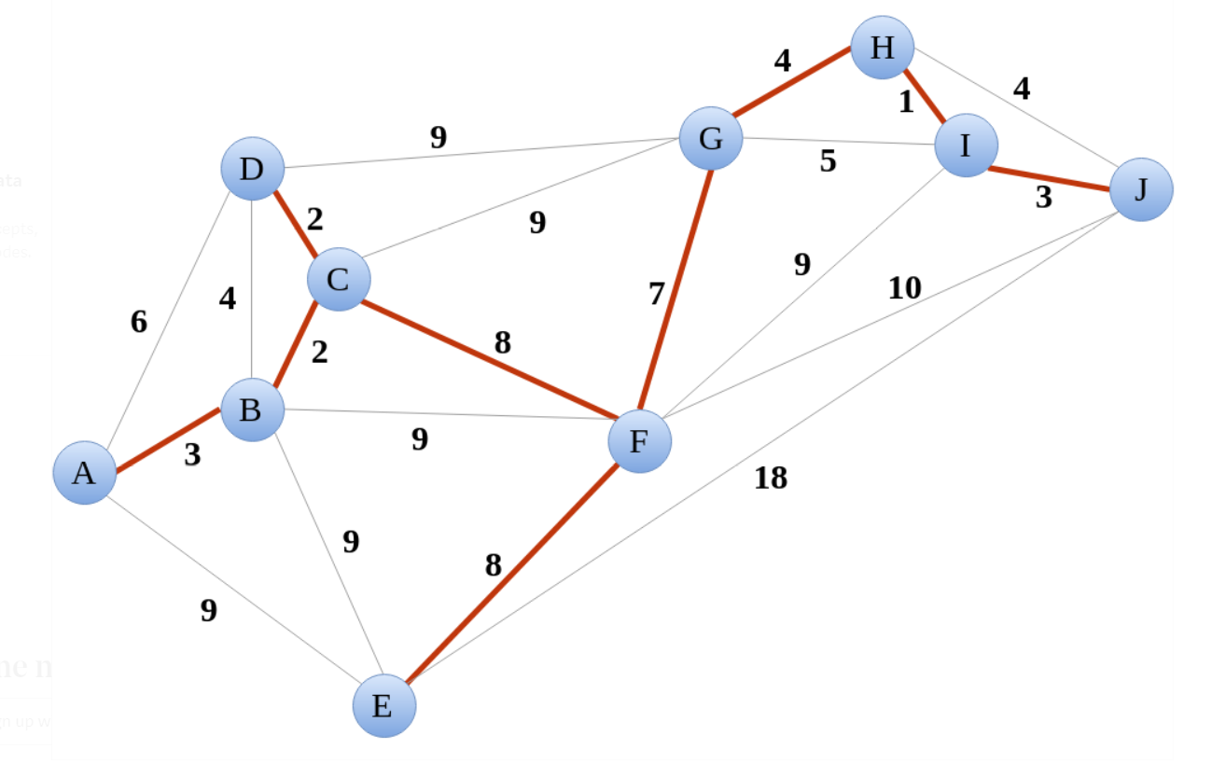
Greedy Algorithm for Graph Traversal
Minimum Spanning Tree Example
Removing the edge that are responsible for forming a cycle in a tree

Slide 48
Greedy Algorithm for Graph Traversal
Dijkstra’s Algorithm Minimum Spanning Tree Example
Minimum spanning tree conditions
G=(V, E) must be directed
Edge weights must be non negative
9
8
13
10
14
∞
∞
b
1
d
b
1
d
10
10
a
9
a
9
2
3
4
6
start
2
3
4
6
5
c
e
5
c
e
2
2
∞
∞
5
7

Slide 49
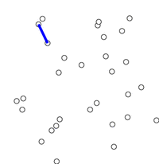
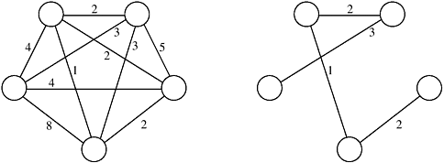
Greedy Algorithm for Graph Traversal
Prim’s Algorithm for Minimum Spanning Tree (MST)
The idea behind Prim’s algorithm
Every two disjoint subsets of vertices must be connected to make a Spanning Tree
They must be connected with the minimum weight edge to make it a MST
At every step of Prim’s algorithm
Find a cut of two sets (vertices already included in MST and other not included varices contains)
Pick the minimum weight edge from the cut and include this vertex to MST Set (the set that contains already included vertices). In another words, choose the next lest costly edge that do not create cycle
Example

Slide 50
Greedy Algorithm for Graph Traversal
Prim’s Algorithm
Initialize Sta[] with the start vertex, s, and Rem[] with the remaining vertices, r in which (v-s=r)
for all r in Rem[]
Set pat[r] to s
if there is an edge (s, r)
Set dis[v] to w(s, r)
else
Set dis[r] to ∞
while Rem[] is not empty
for all unvisited u in Rem[] , find the smallest dis[u]
Remove u from Rem[] and add it to Sta[]
Insert the edge (u, pat[u]) into the spanning tree.
for all v adjacent to u in Rem[]
if weight(u, r) < dis[r]
Set dis[r] to weight(u, r)
Set path[r] to u.

Slide 51
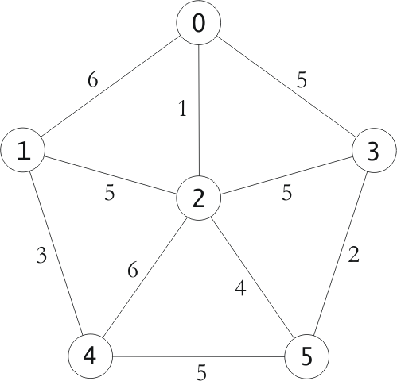
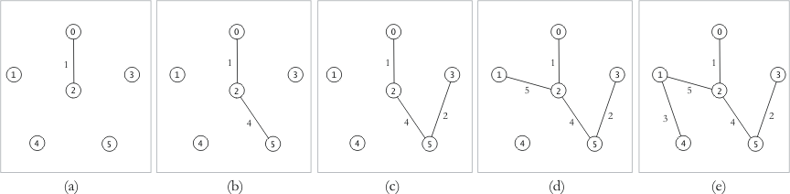
Greedy Algorithm for Graph Traversal
Prim’s Algorithm for Minimum Spanning Tree Example

Slide 52
Greedy Algorithm for Graph Traversal
Analysis of Prim’s Algorithm
The outer loop is executed v-1 times, each time adding an edge
There are two inner loops:
One to find the minimum item in the remaining list,
The other to update the distances from nodes inside the set U to nodes outside the set U
These loops also run |V| times
Thus the implementation is O(|V|²) assuming that the adjacency matrix representation of the graph is used
If we could improve upon the find minimum and update distance operations to say log |V|, this could be improved to O(|E|log|V|)
Computer science researchers have developed advanced priority queue implementations that give O(|E| + |V| log |V|) or better performance

Slide 53
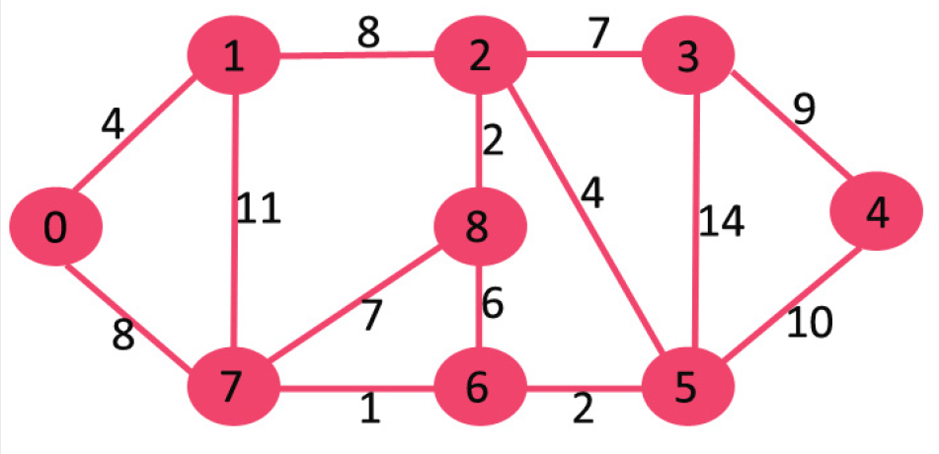
Graph: Tutorial 1
Use Dijkstra’s algorithm to find the shortest path of the following graph
Reference: Dijkstra’s shortest path algorithm | Greedy Algo-7- GeeksforGeeks

Slide 54
Graph: Tutorial 2
Use Prim’s Minimum Spanning Tree (MST) algorithm to simplify the following graph
Reference: Prim’s Minimum Spanning Tree (MST) | Greedy Algo-5 - GeeksforGeeks

Slide 55
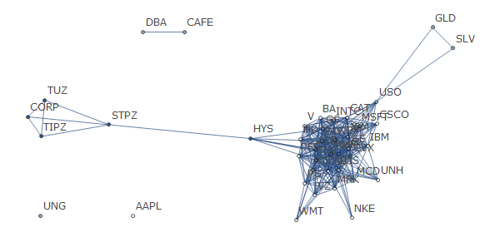
Thank You
ALGORITHM & COMPLEXITY

